Slide 1



FITNESS TRACKING & WORKOUT MANAGEMENT SYSTEM
F
F
GROUP# 7
This database design will form a foundation for a user-friendly fitness application, enabling users to interact with their fitness data and receive recommendations to achieve their goals.
IT’S NEVER TOO EARLY OR TOO LATE TO WORK TOWARDS BEING THE HEALTHIEST YOU.
FIT
FUSION
CONTACT
ASEEM DESHMUKH
RIYA SETHI
SHEETAL PUJARI
HIMANSHU WALIA
KARTHIK PANGHAT
HEALTH IS A JOURNEY, NOT A DESTINATION

Slide 2


PROJECT OBJECTIVES​
Create user data with the personal information and fitness goals
Create daily work out plan, information about sets and repetitions and track cardio
Provide workout plans according to fitness goals (weight loss/gain, muscle mass gain, strength improvement etc.)
Provide a progress report of weight loss/gain, BMI etc.
Provide customized diet plan to achieve the fitness goals.
Provide a space for sharing the fitness journey and achievements and interacting with fellow fitness enthusiasts.
PROJECT OVERVIEW​
The project focuses on designing a comprehensive database for fitness tracking and management which can be used by a fitness business or a fitness enthusiast. The database enables user to track their fitness goals easily through a digital platform.
By making health and fitness accessible, the project aims to contribute to a healthy lifestyle to its users.

Slide 3
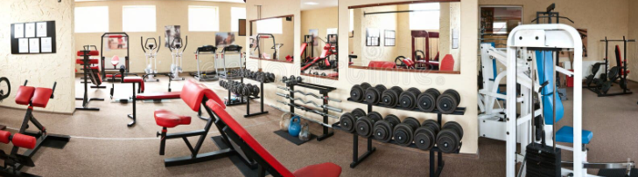
SUMMARY OF DESIGN
User Centric Data Model and Provides Flexible Goal Management
Tables are structured around user information like user, fitness goals, progress report and community
Model encompasses personalized training plans and diet strategies
Provides Enhanced Functionality and Data Integrity & Security Measures
Implemented stored procedures for optimizing data access
Integrated error handling strategies to limit the length of posts.
Utilized UDFs to compute columns as well to offer personalized recommendations based on specific user attributed.
Ensured data integrity with check constraints, foreign key relationships, and cascading delete operations.
Applied data encryption for sensitive user information (User email)

Slide 4
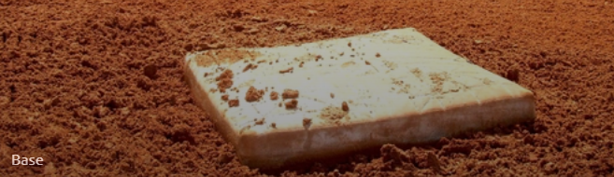
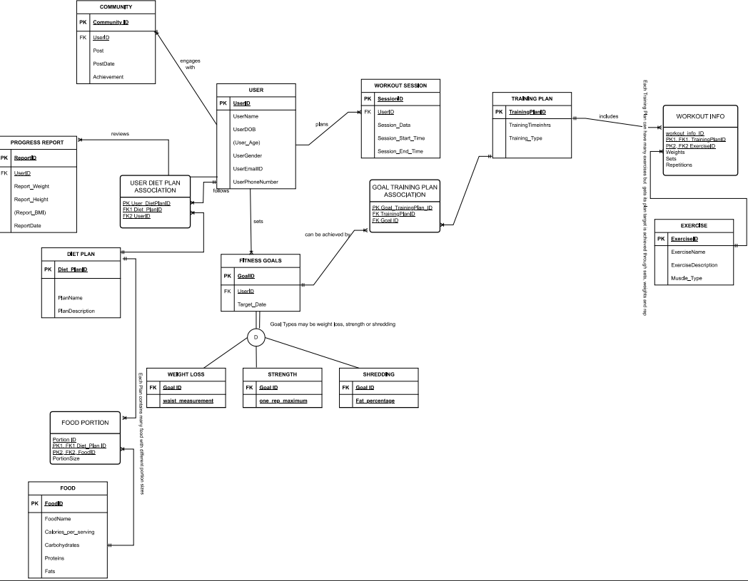
Erd diagram
There are 16 entities where USER and FITNESS GOALS forms the database core.
USER can view his gym progress through PROGRESS REPORT
FITNESS GOALS has 3 Subtypes and USER is related to TRAINING PLAN and EXERCISE through FITNESS GOALS and related associative entities
All M-M relationships are converted using associative entities
USER has access to DIET PLANs and its associate FOOD.
USER can enrich their experience through COMMUNITY ENGAGEMENT
Age, BMI and Target weeks are computed using its associate attributes

Slide 5
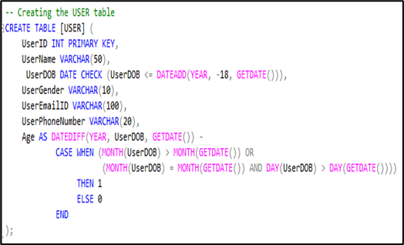
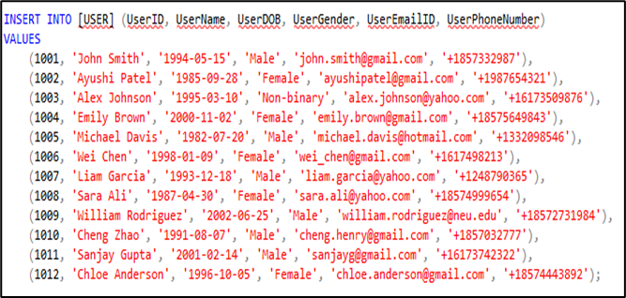
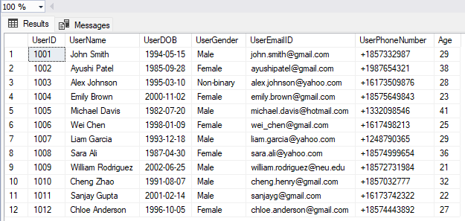
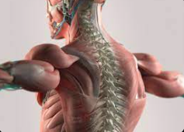
USER CREATION AND INSERTION
MAIN ENTITIES & ASSOCIATIVE ENTITIES
USER
WORKOUT SESSION
FITNESS GOALS
PROGRESS REPORT
DIET PLAN
FOOD
TRAINING PLAN
EXERCISE
COMMUNITY
WEIGHTLOSS
STRENGTH
SHTREDDING
USER DIET PLAN ASSOCIATION
GOAL TRAINING PLAN ASSOCIATION
WORKOUT INFO
FOOD PORTION
DDL STATEMENTS: The Backbone of Database Architecture

Slide 6
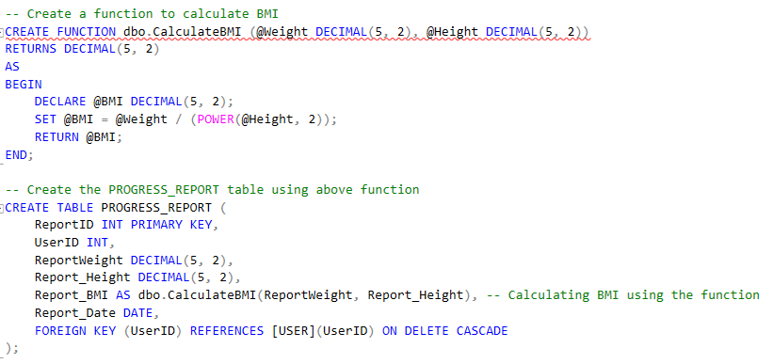

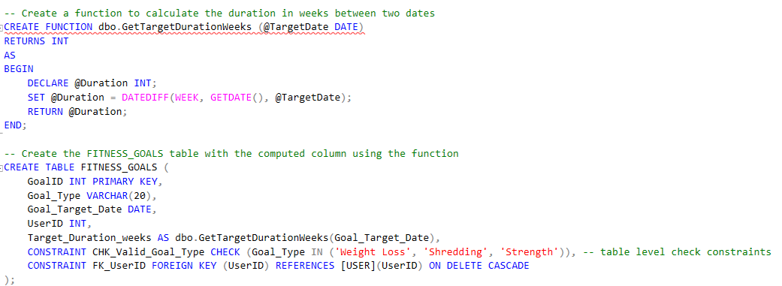
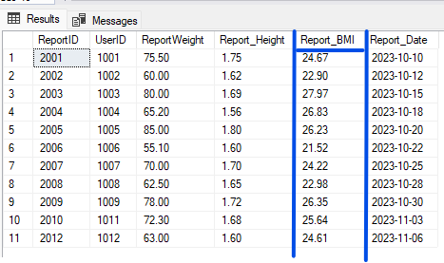
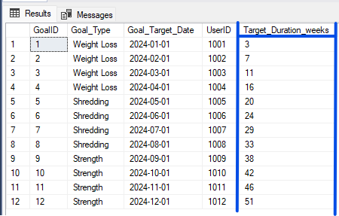
COMPUTED COLUMNS (BASED ON UDF)
Calculate BMI
Calculate Target Duration in Weeks

Slide 7
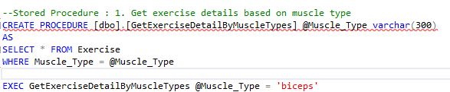

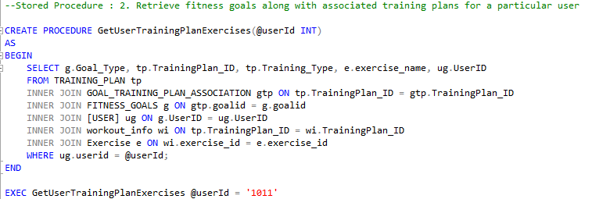
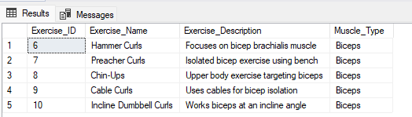
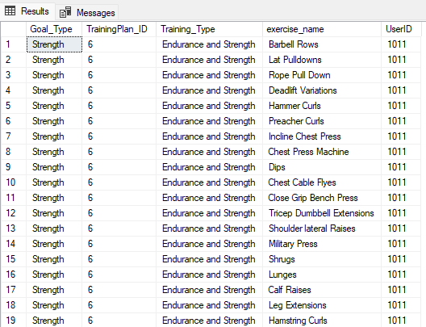
Stored PROCEDURES
Exercise Details based on Muscle Type
Goal + Training Plan + Exercise Name

Slide 8
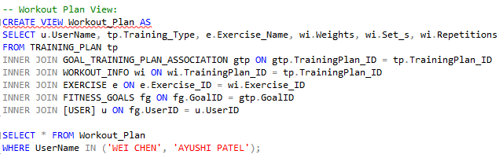
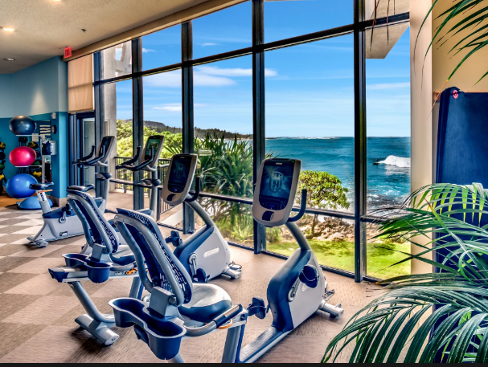
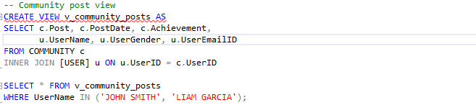
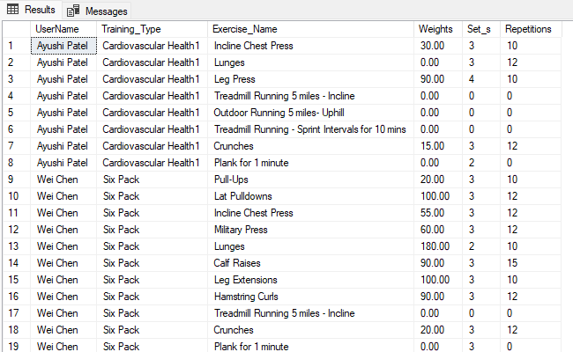
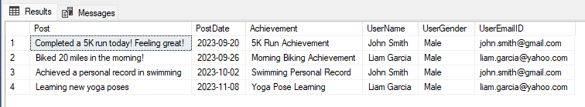
vIEWS
Posts from Different Users
Work Out Plan based on User

Slide 9
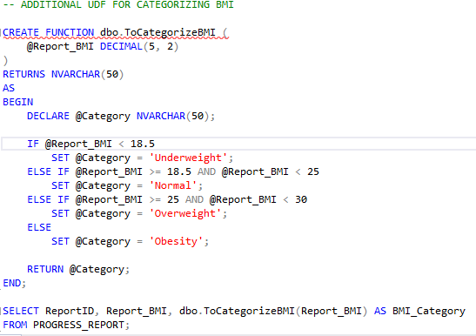

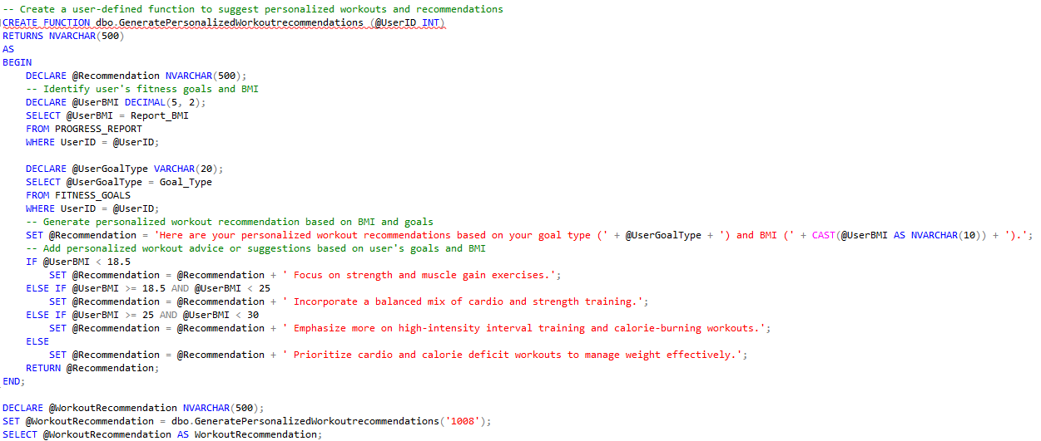
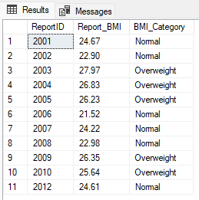
USER DEFINED FUNCTIONS
Categorizing BMI
Customized Recommendations based on BMI

Slide 10
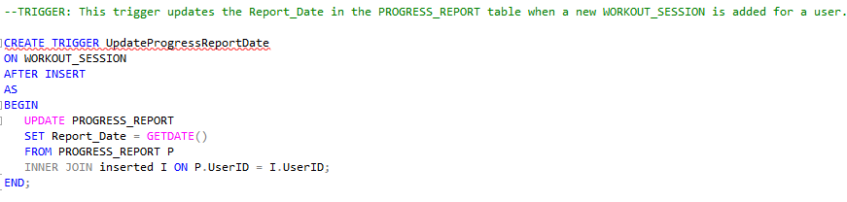

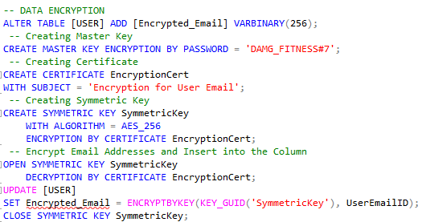

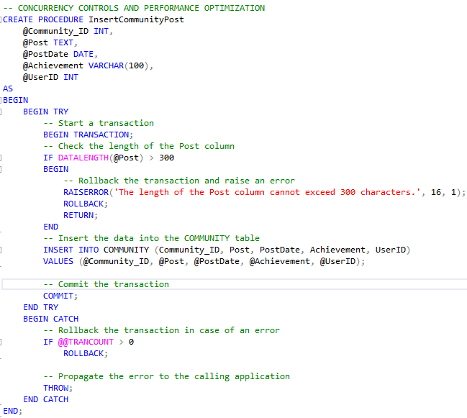
Trigger, data encryption & error handling
Trigger to update report date when a new session is added by User
Data Encryption on User Email
Error Handling: To limit the post length

Slide 11
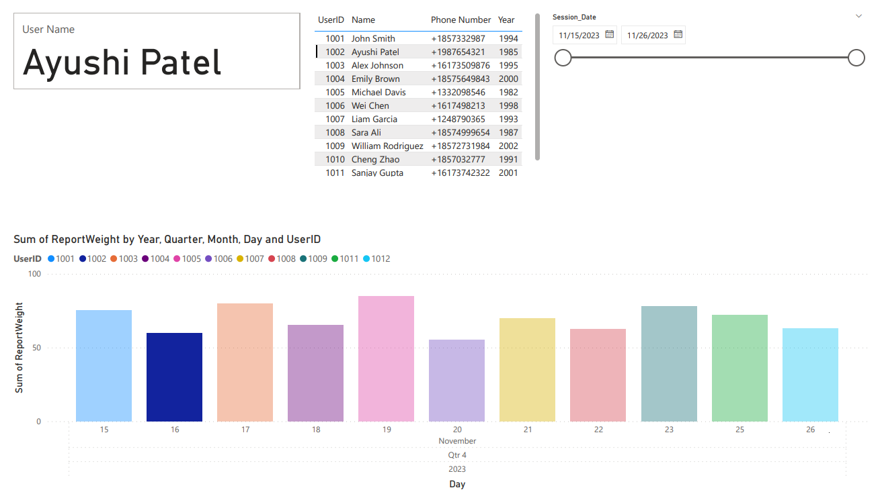
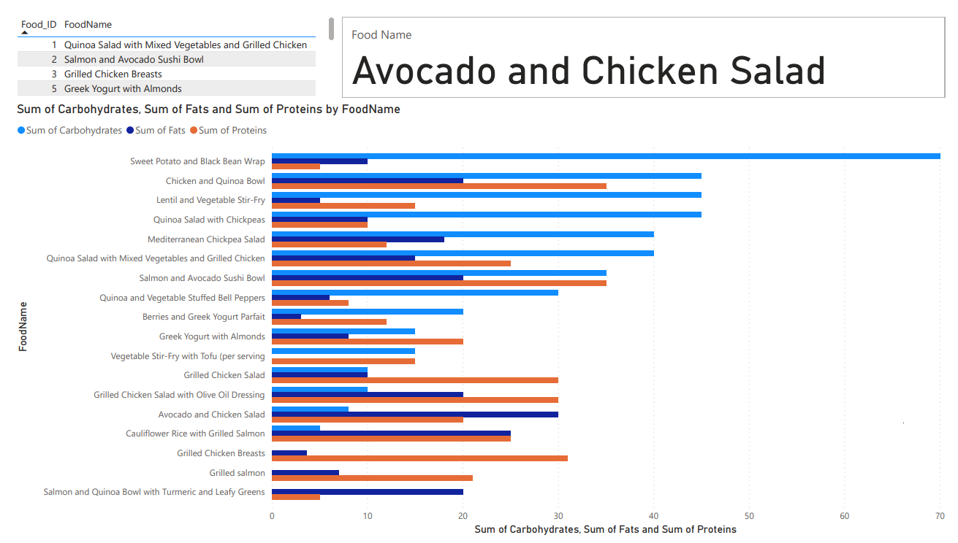
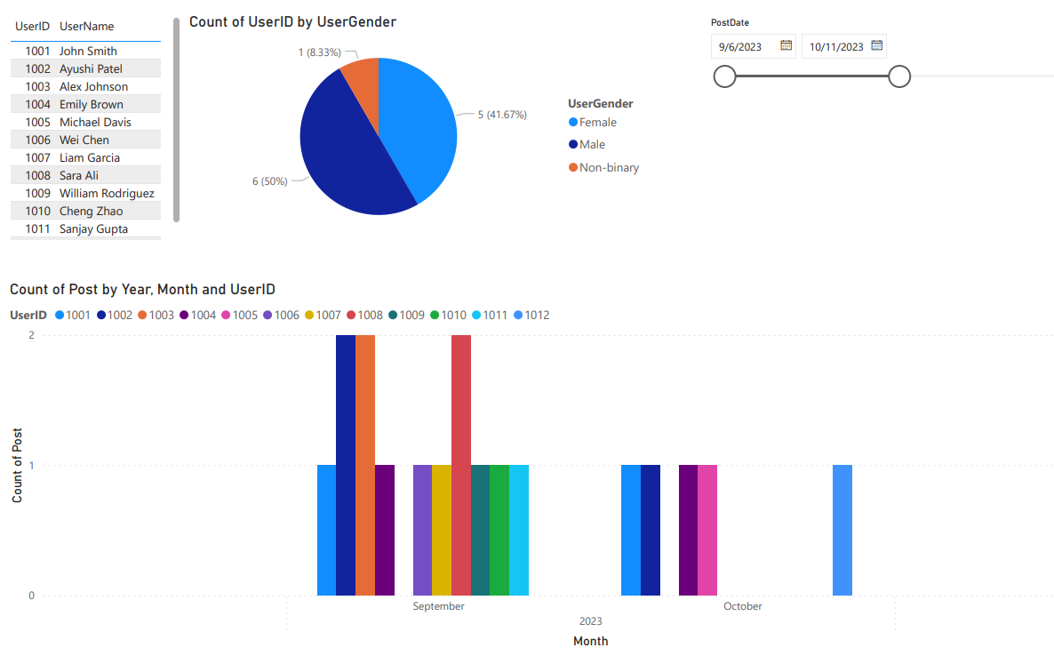
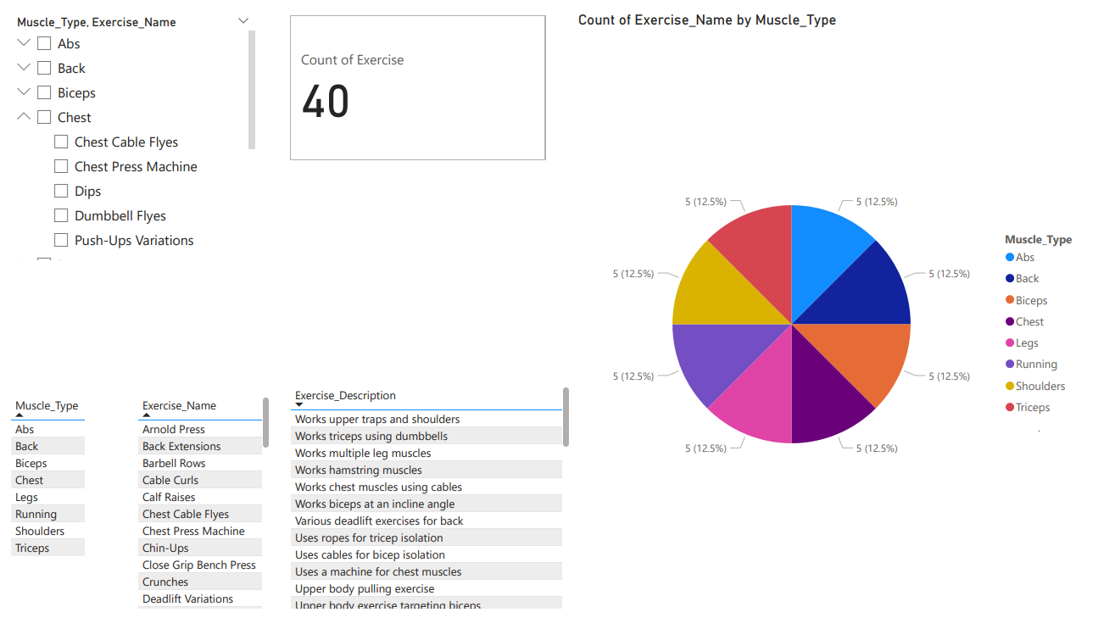

Slide 12
Thank you
F
F
Empower your body, energize your mind
ANY QUESTIONS?
FIT
FUSION
Journey to strength, one workout at a time

